Slide 1
5.5 Adding Photo Gallery Module
BOX 1 – Title of the Photo
BOX 2 – Full description of the Photo
BOX 3 –Source or Credits of the Photo
SET PHOTO DATE – e.g. Date of the Photo was taken.

Slide 2
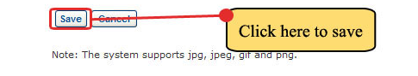
5.5 Adding Photo Gallery Module
Step 4. Click the Save button to upload the added photo.
After saving, the NCBH index page will reappear with the added photo

Slide 3
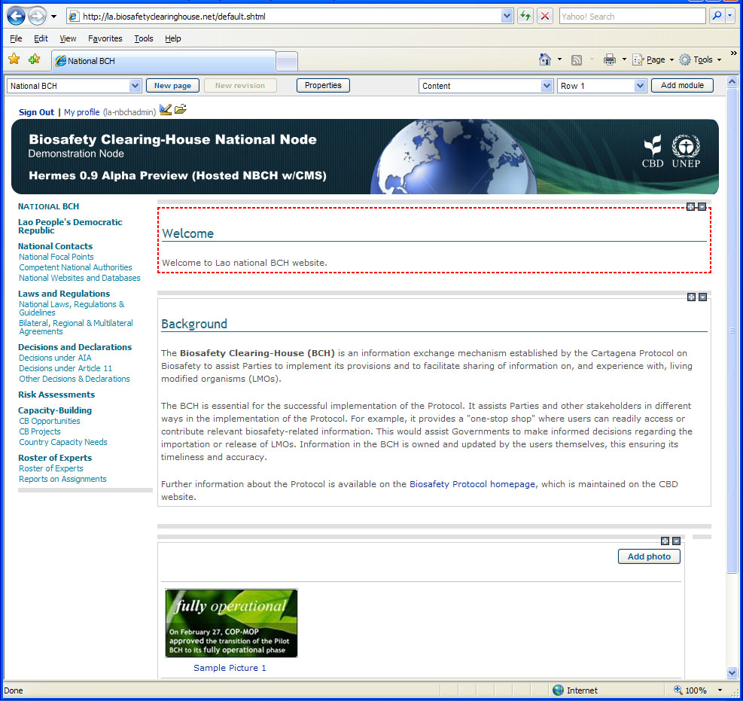
5.5 Adding Photo Gallery Module
NEWLY UPLOADED PHOTO

Slide 4
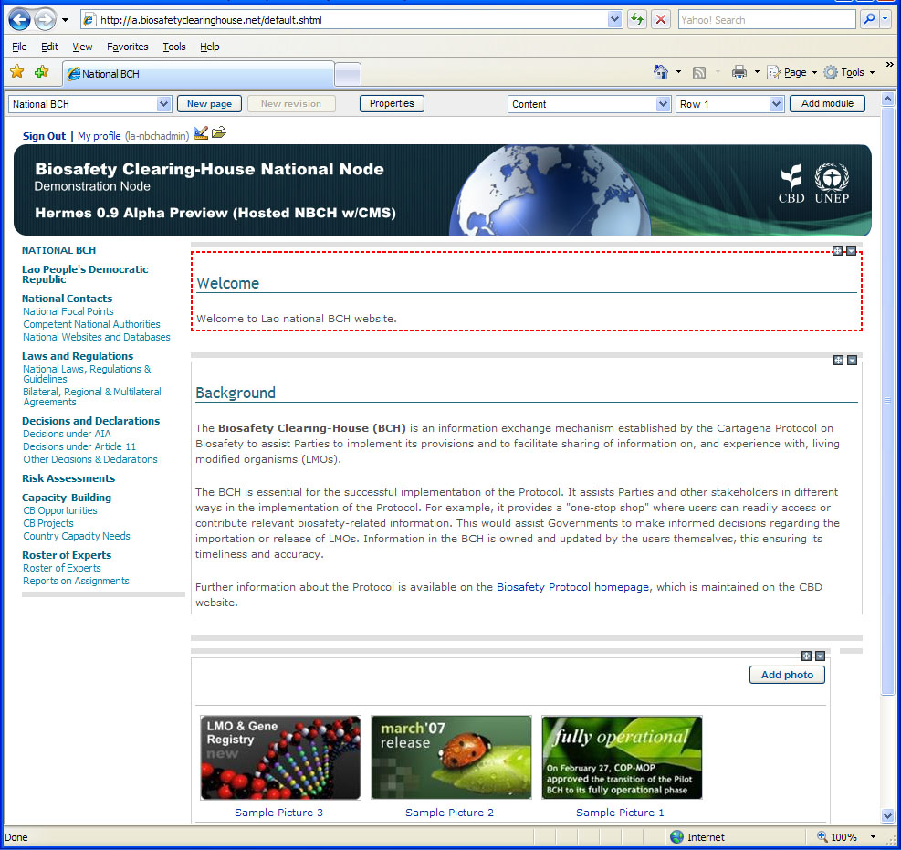
5.5 Adding Photo Gallery Module
To add more photos, just click on the Add photo button.
Then follow the same procedure discussed above.
An example shown is the index page with three (3) photos attached.

Slide 5
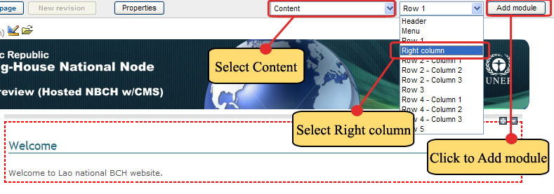
5.6 Adding more modules to a page
Example. Adding Content Module with Right Column Position.
Step 1. Select Content as the Module Type and Right Column as the position then click on Add Module button as shown.

Slide 6
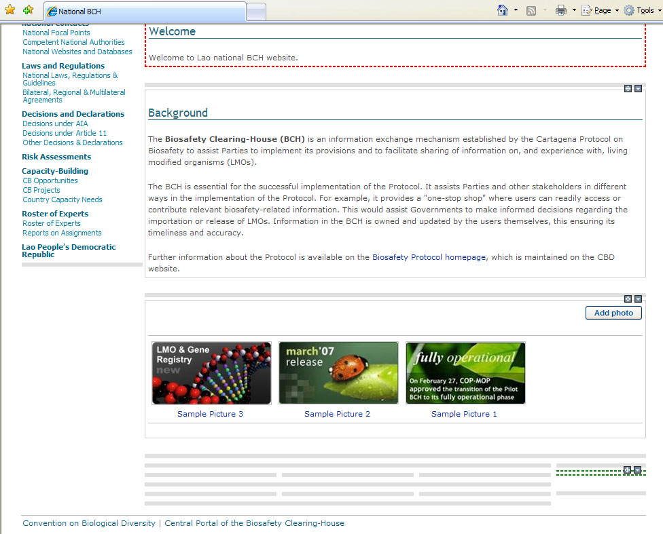

5.6 Adding more modules to a page
A new module will be added in the index page positioned below the Photo Gallery Module.
NEWLY ADDED RIGHT
COLUMN MODULE

